Slide 1
The tree map
The tree map

Slide 2
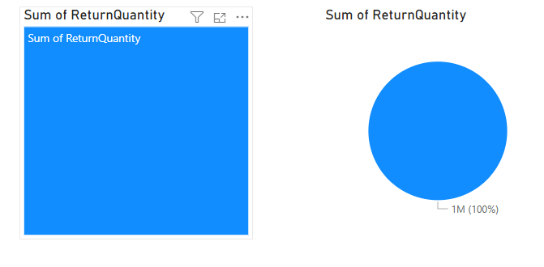
The tree map
This workshop is using Sales.xslx de Excel Sources
Add the TreeMap and Pie visualizations to the scene level and configure both visualizations to display the ReturnQuantity from FactSales table

Slide 3
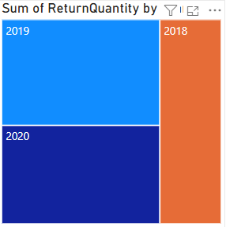
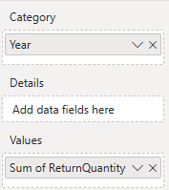
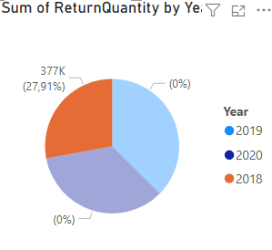
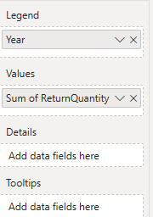
The tree map
Note that to configure TreeMap there is a difference compared to Pie in that the Legend parameter becomes Category in the case of TreeMap

Slide 4
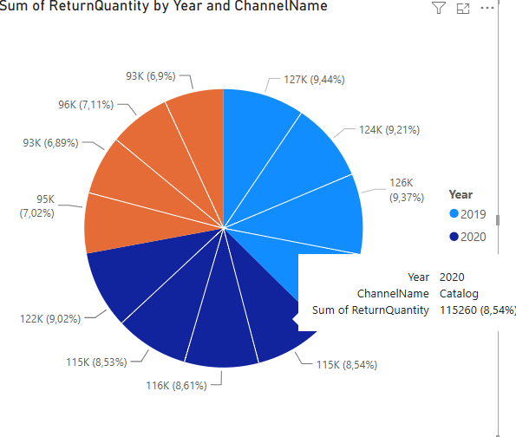
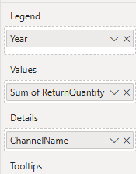
The tree map
Remark the presence of Details field in both kinds of visuals

Slide 5
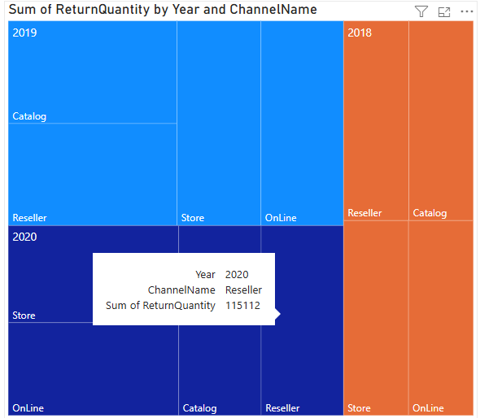
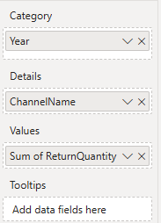
The tree map
Also for the TreeMap Details field

Slide 6
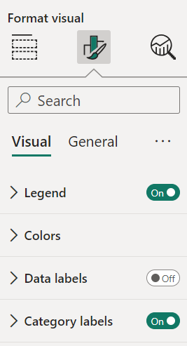
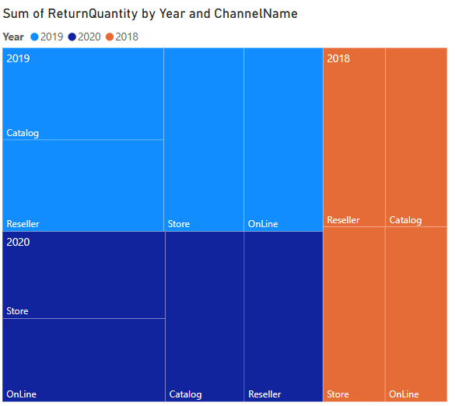
The tree map
Add a legend to the TreeMap level by selecting the Format section then activation Legend

Slide 7
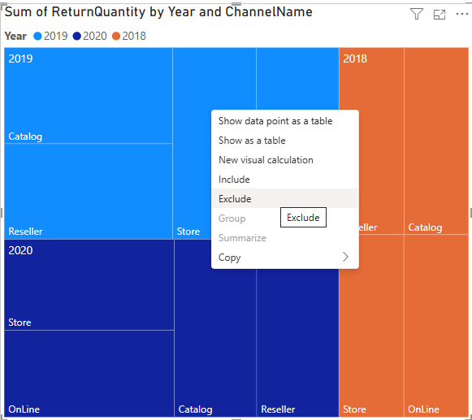
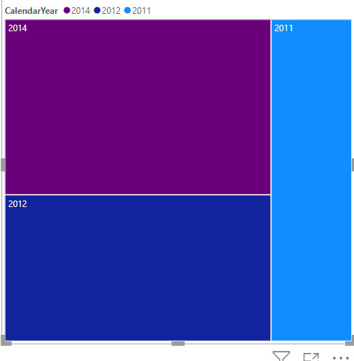
The tree map
It is possible to exclude or include sectors in both cases of visualizations , by right-clicking and selecting include or exclude

Slide 8
Thank you
Thank you

